Slide 1

ONLINE CLEARANCE SYSTEM FOR GRADUATING STUDENT
PREPARED BY: GIFT EMERALD ONYI (CST20HND0389)
SUPERVISED BY: MR. DR. OBASAN ADEBOLA OLUKAYODE

Slide 2
Table of Content
1
Background of the Study
2
Statement of the Problem
3
Aims and Objective of the Study
5
Summary of Literature Review
6
Research Methodology
4
Significance of the Study
7
System Modeling
8
Proposed Interface Design
9
Summary / Conclusion
Presentation Title
ONLINE CLEARANCE SYSTEM FOR GRADUATING STUDENT

Slide 3

Background of Study
Before receiving other important documents like certificates and comparable other sensitive things, students in an academic setting are required to show certain critical documents as proof during their clearance (Nneji & Monday, 2018). This means that to gain access, a person must pass through a few departments, each of which is often responsible for carrying out a certain task (Fatima, 2021). This is the situation with students who are in their last year of study and whose results must be cleaned before they can be properly awarded their diplomas.
Since it is customary for final students to walk from one office to another while waiting to be cleared (Usman et al., 2017), and because this practice is usually well documented on paper for record-keeping purposes, even more, every clearing activity is completed manually. However, the majority of organizations understood that the data recorded during student clearance is vulnerable to harm and may even be lost or stolen. In response, several schools began automating the procedure. Due to this, computers are now being used to keep track of the student’s records. It is noteworthy that tertiary institutions have developed an interest in the numerous online educational possibilities due to recent technological advancements (Fatima, 2021).

Slide 4

Statement of the problem
Handling student clearance information and the clearance procedure is done manually. This processing technique takes a long time and is frequently inconvenient. This can be attributed to a variety of issues, including the processing of the clearance form taking longer than anticipated and the absence of key employees who are critical to the clearance's development. The procedure of signing and submitting the essential documents to show that one is a genuine student of the school can be highly hard because there is no predetermined or structured manner of doing so. Students are trapped with the tedious and time-consuming procedure of walking in circles from office to office seeking staff members who can sign, stamp or validate some payment or another.

Slide 5



Aim and Objectives of the Study
Aim
The aim of this study is to develop an online clearance system for graduating students at Kaduna polytechnic
Objectives
To review the related literature on the online clearance system for graduating students at Kaduna polytechnic.
To design or develop an online clearance system to meet graduate clearance needs.
To implement the system and evaluate its efficiency in terms of system information needs / output.

Slide 6

Significance of Study
After completing this project research, the clearance process in Kaduna polytechnic will be computerized, which represents a significant step toward a more efficient and productive clearance process, as the manual means of clearance has been written; it will also make clearance possible from anywhere in the world, as it will be an online system
ONLINE CLEARANCE SYSTEM FOR GRADUATING STUDENT

Slide 7
Summary of literature review
Title | Author & Year | Description | Merit | Demerits
Design and Implementation of an Open-Source Web-Based Clearance System for Iraqi Educational Institutions. | Ramadhan et al. (2020). | The system enables students to do their clearance much easier and faster. | The whole data and the process is centralized with a web-based system | Some areas of the system lack maintenance.
An Improved e-Clearance Management System for Graduating Students in a University Environment. | Grace et al. (2018). | The e-clearance system is a web-based method that enables graduating students to complete their final year clearance electronically or online. | The system will provide graduates with a smooth clearance experience. | The system may lack scalability probably due to the influx of users.
Online clearance management system. | Mohammed (2021). | The system will replace the manual method of clearance during withdrawal, summer vacation, and graduating time for students. | The system eliminates all sorts of time delays and tension while also allowing you to comprehend the procedure. | Poor user interface.

Slide 8
Summary of literature review
Title | Author & Year | Description | Merit | Demerits
Development of an Online Clearance System for an Educational Institution. | Jonathan et al. (2019). | The project uses a case study method to develop a functioning prototype of a comprehensive manual system for a prominent institution of learning in Southwest Nigeria. | The new approach will minimize the amount of time and effort spent on student clearance, as well as the expense incurred by the institution on paper. | The system is strictly a web-based application.
A Web-Based Database-Driven Students' Clearance System. | Agbo-Ajala and Makinde. (2017). | The project's goal is to design and build an online student-clearing system utilizing PHP and MySQL that will reduce human delays and provide a central repository for students to be cleared. | The system creates a central repository for students that need to be cleared. | The usability of the system is poor.

Slide 9

Research methodology
Choice of programming language
Method of data collection
This research work will be a web-based application and will be implemented on a relational database system (SQLite). HTML (hypertext markup language), CSS (cascading style sheet), and JavaScript will be employed in the front end while Django(python) will be employed for the backend programming. The above are the modern languages used in implementing this system
Before developing any system, collecting data and facts about the existing system is critical to understand what is going on. This research was carried out using three methods.
Observation of the Work Environment
Interview
Documentation

Slide 10
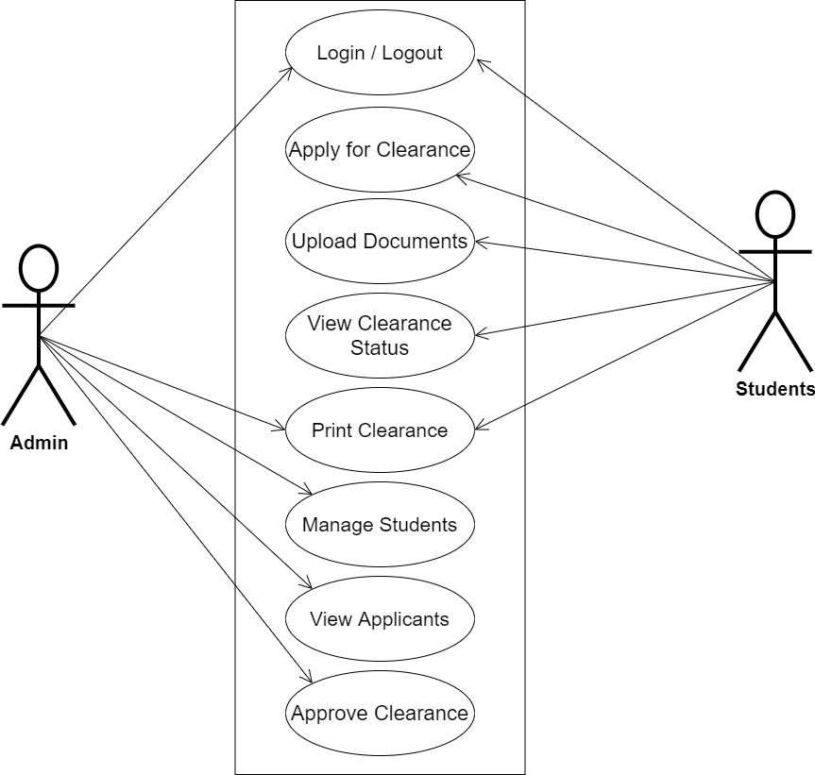
System Modeling (Use Case Diagram)
System Use Case Diagram

Slide 11
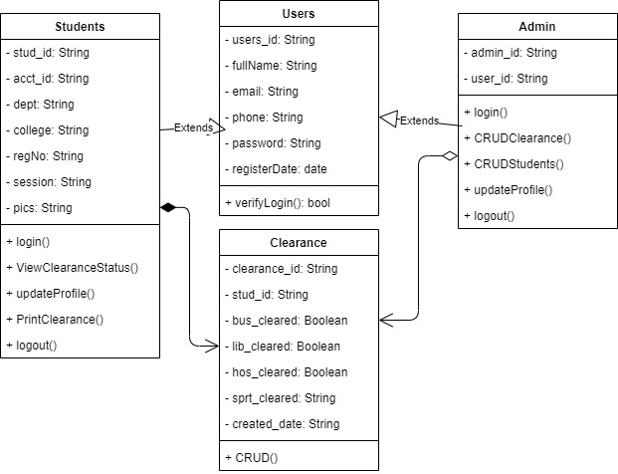
System Modeling (Class Diagram)
System Class Diagram

Slide 12
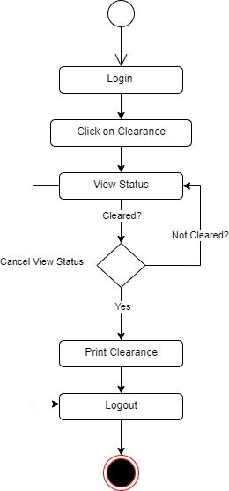
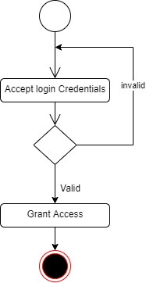
System Modeling (Activity Diagram)
User Login Activity
Clearance Status Activity

Slide 13
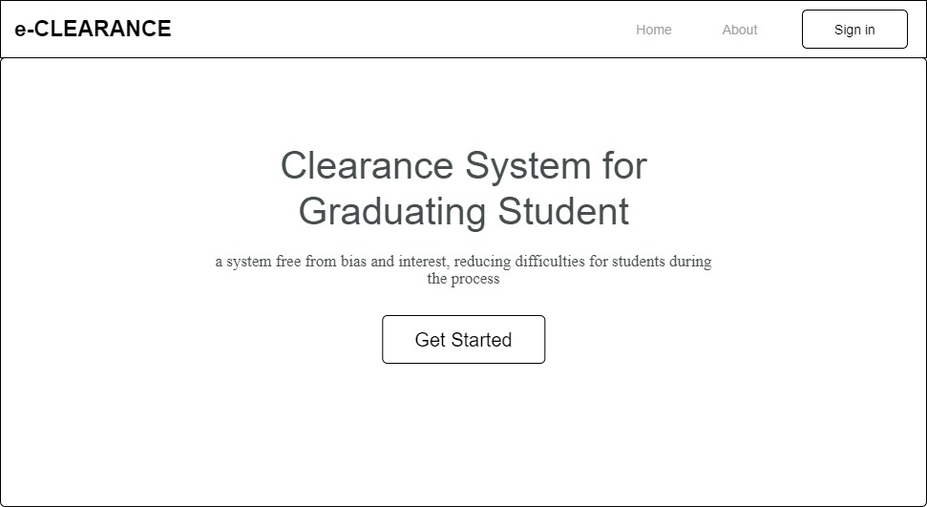
Proposed Interface Design
Homepage

Slide 14
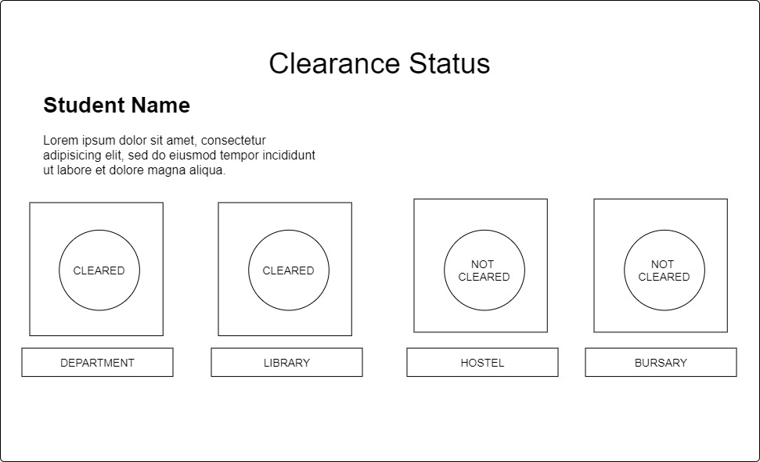
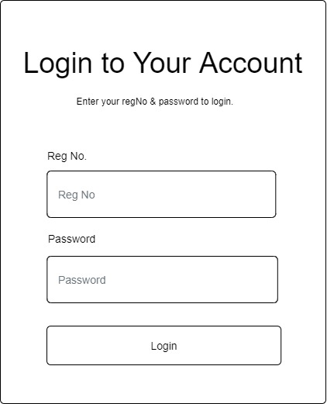
Proposed Interface Design
Clearance Status Page
Login Form

Slide 15

Summary
This research work would include an investigation of the current methods used in clearance, and an evaluation of the feasibility and potential benefits of implementing an online clearance system. The research work will only be cleared for graduating students and not for departmental clearance
ONLINE CLEARANCE SYSTEM FOR GRADUATING STUDENT

Slide 16

Thank you

